Slide 1

Project 2: Economic ETL
MaryClare Colombo
Victoria Barbosa Munoz
Jorge Hernandez
Sviatoslav Piasta
Keith Moravec
John Tanasijevich

Slide 2
Question
How have economic indicators that most impact ordinary people changed over time?
Why?
For future data analysis to see if these indicators are correlated
To understand how the economic challenges facing ordinary Americans has changed over time
To see if the cost of basic needs have increased faster than wages

Slide 3
Indicators of interest
Median House Prices
Gas Prices
College Prices
Median Income
CPI (Consumer Price Index)
Population
30 Year Mortgage Rate
Notes:
-does population growth impact the other econ indicators differentially

Slide 4
ETL Proposed Methodology
Download all data into a Panda’s DataFrame (df)
Standardize all date formats and intervals
Create Schemata in Postgres - each df will be a table - PK=Date
Load df to Postgres

Slide 5
Challenges
Column names were uninformative
Dates were not in datetime format
Dates were either daily, monthly, or annually in original csv files
All files had different start dates
Missing data

Slide 6
E - Extract
All CSV files
Median House Prices (Source: FRED)
Gas Prices (Source: FRED)
College Prices (Source: EducationData)
Median Income (Source: FRED)
CPI (Source: FRED)
Population (Source: FRED)
30 Year Mortgage Rate (Source: FRED)
Notes:
Extract – CSV (preferred bc easier to convert to pandas df), Json, SQL

Slide 7
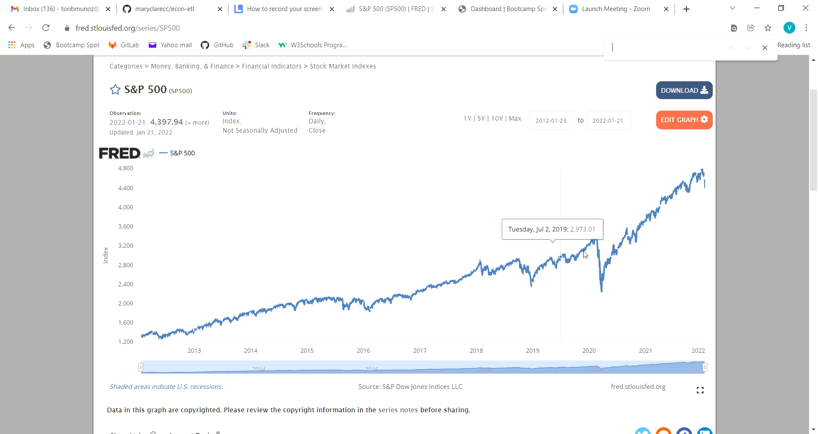
E - Extract
Notes:
Extract – CSV (preferred bc easier to convert to pandas df), Json, SQL

Slide 8
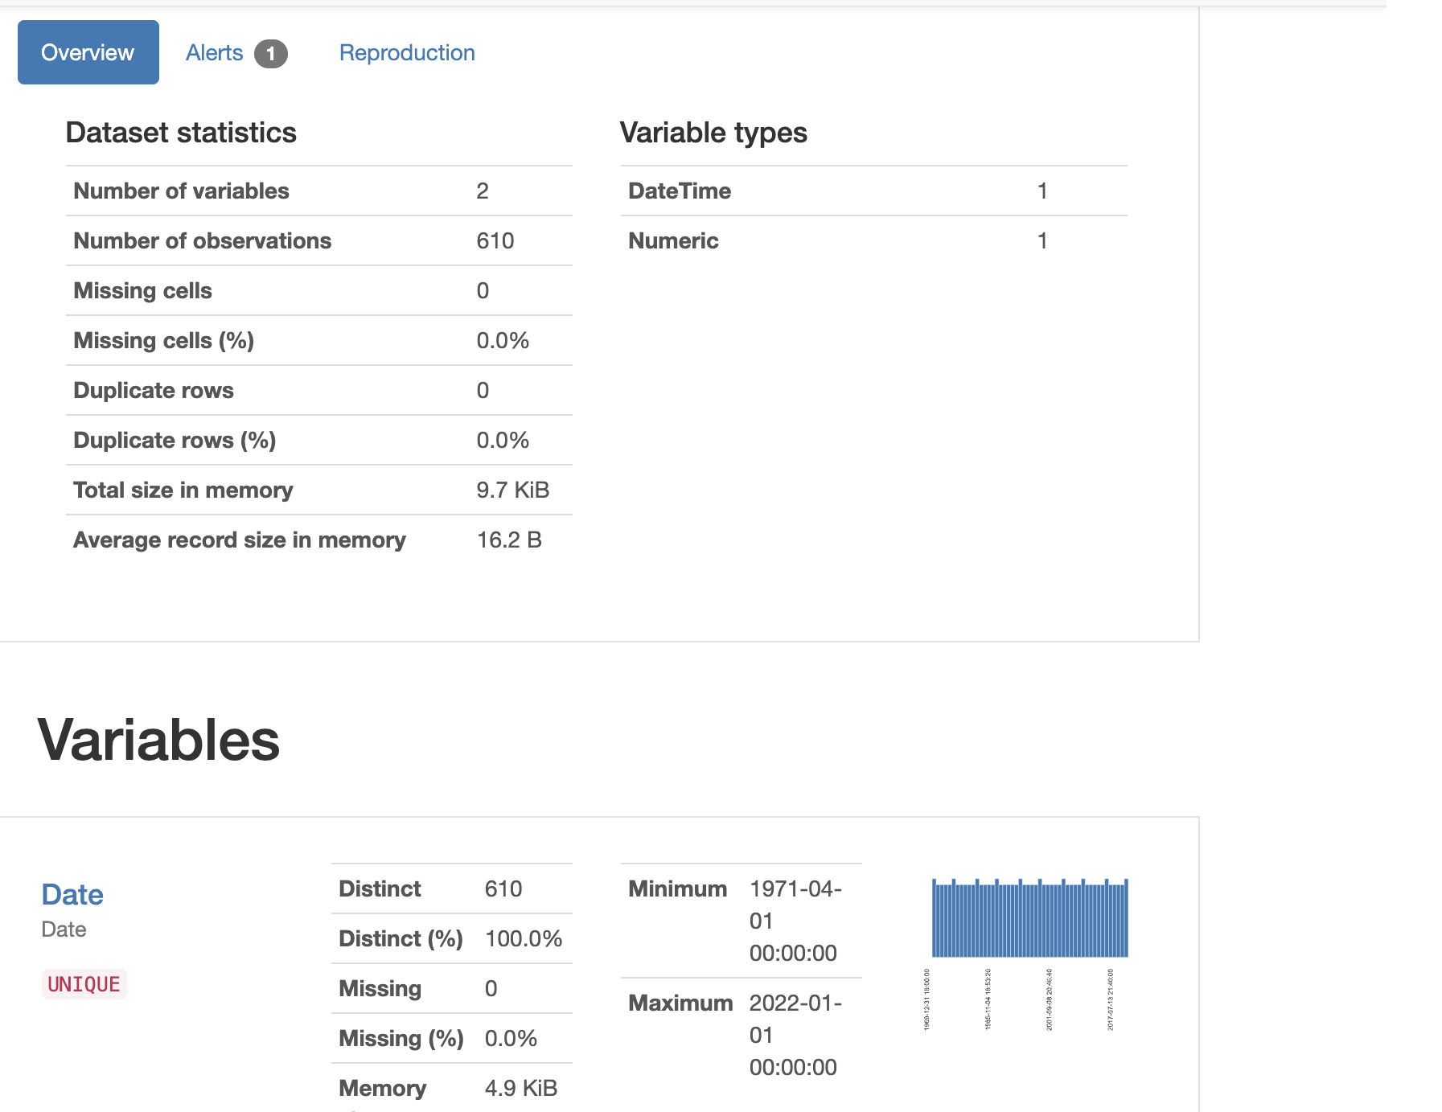
T - Transform

Slide 9
T - Transform
Renaming columns
Formatting dates so they are all the same
Pandas .profile_report
Formatting columns so they are all numerical
College was categorical due to dollar signs and missing data
Interpolate to fill in missing values to then convert to int
Bfill vs ffill to deal with unavailable data

Slide 10
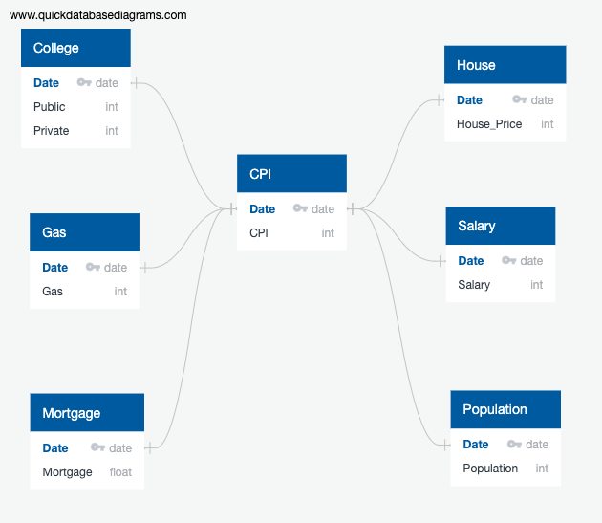
L - Load
Relational Postgres database
PK = Date
All files were indexed by date

Slide 11
Sources
FRED https://fred.stlouisfed.org
EducationData.org

